Slide 1

WRITING GOOD REPORTS
Satria Ady Pradana

Slide 2
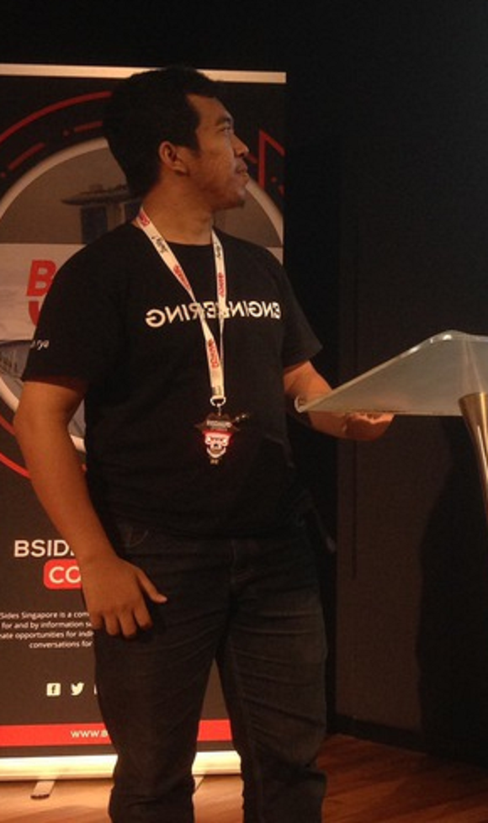



Who?
Satria Ady Pradana
Cyber Security Consultant at Mitra Integrasi Informatika
Co-Founder of Archonlabs SSD
Penetration Tester, Red Team
Community Leader of Reversing.ID
@xathrya
xathrya
xathrya_

Slide 3
REPORTING 101
What are needed for good report?

Slide 4
Reporting
Report is crucial part for any service providers (IT service/advisory).
Describing activities in engagements.
As reference for actions.
Target audience might vary.
Technical detail will be read by security team, developers, or administrators.
Executive summary will be read by management.

Slide 5
Why Important?
Give most useful and concise information.
Responsible team can understand and mitigate the bugs/issues/findings faster.
Leads to fewer questions from the team.
Your clients might use it for complying with regulations.
More heads read your report but same interpretation.
Your client has been breached
Your report is needed to give second opinion for investigation

Slide 6
What inside?
Format might vary, but should include:
Executive summary
Methodology
Scope
Testing perspective (black/gray/white box)
Timeline
Detail of each findings
Conditions during testing

Slide 7
What is Good Report?
Make reader understand what happen with sufficient information you provide.
When writing a report, try to read your report as technical and non technical people.
When describing finding, give clear description.
Give sample scenario and real-world impact.
Concise reproduction steps.
Working examples.

Slide 8
Sensitive information
Ensure sensitive information won’t fall into the wrong hands.
Address
Credentials
Network maps
Technology used
Security details
Security issues/findings
If you have to include them, mask it.

Slide 9
Findings
Good findings need
good explanation

Slide 10
Describing Findings
Describe the finding clearly.
What is the root cause?
What is the impact?
Which components are affected?
What privileges are required to execute this attack?
What does attack flow look like in practice?

Slide 11
Impact
Think like attacker
Give real-world scenario and possible abuse of this finding.
What can attacker accomplish with this?
Grab the most important to the business behind the application
How vulnerability can be used?
Business unlikely care about technical stuffs, they care about:
User information being accessed or destroyed
Fraudulent orders

Slide 12
Screenshots
What the screenshot tells?
Affected page/components.
Parameters/fields affected.
Focus on what you want to convey
Don’t take whole screen
Give proper highlight to important stuffs

Slide 13
Proof of Concept (POC)
Reproduction steps for confirmation
Technical team should be able to follow each steps.
Be concise, don’t write anything unnecessary.
Avoid assumption
Not everyone know your super-cool tools.
Security team might not know the flow of application (or features).
Describe your payload
If you make custom script, present it.

Slide 14
Recommendation
The best way to fix this problem.
Should address the root cause you present!
Affordable (technically or economically).
Solving problems and not creating problems.
Avoid recommending specific product!
If you know the code snippet to fix it, write it down.
But developers know their application better, so just keep it as recommendation not mandatory.

Slide 15
Measuring the risk
Quantify the severity of findings.
Help technical teams prioritize fixing the findings.
Some available toolset:
CVSS (Common Vulnerability Scoring System): https://www.first.org/cvss/calculator/3.1
OWASP Risk Rating: https://www.owasp-risk-rating.com/
Demo?

Slide 16
Sample Report
Offensive Security
Vantage Point
TGB Security
Primo Connect
Pentest Hub
High Bit Security
Pulsar Web
Network Intelligence
Pivot Point Security

Slide 17


Slide 18
Thank You
Satria Ady Pradana
spradana [at] archonlabs.id
@xathrya (telegram)

